Slide 1
COMPREHENSIVE ORDER AND REVENUE ANALYSIS USING SQL

Slide 2
AIM
To analyze and interpret sales data from a pizza chain using SQL by leveraging information from the orders, order_details, pizzas, and pizza_types tables to:
Identify trends in customer ordering behavior.
Calculate key business metrics such as total revenue, most popular pizza categories, and sales by time of day.
Provide actionable insights into revenue distribution, pizza preferences, and peak ordering times for strategic decision-making.

Slide 3
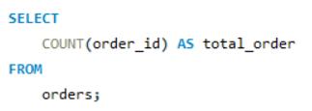
Retrieve the total number of orders placed

Slide 4

Calculate the total revenue generated from pizza sales

Slide 5
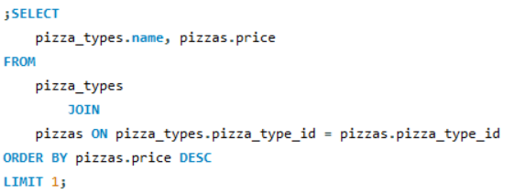
Identify the highest-priced pizza

Slide 6
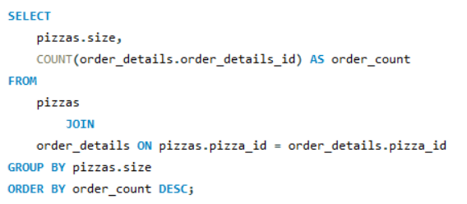
Identify the most common pizza size ordered

Slide 7
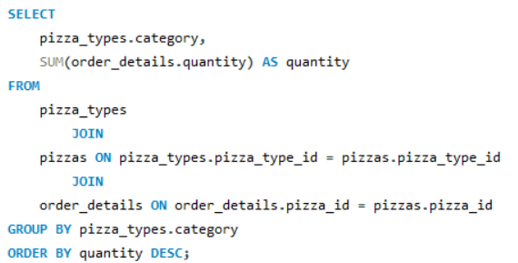
List the top 5 most ordered pizza types along with their quantities

Slide 8
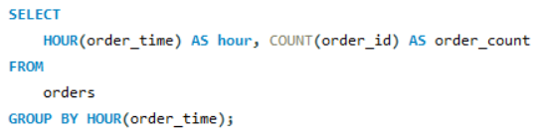
Determine the distribution of orders by hour of the day

Slide 9
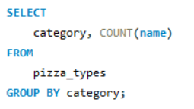
Join relevant tables to find the category-wise distribution of pizzas

Slide 10
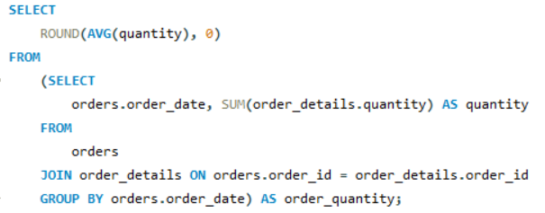
Group the orders by date and calculate the average number of pizzas ordered per day

Slide 11
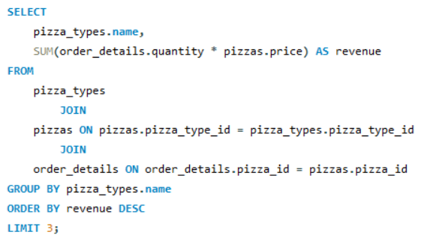
Determine the top 3 most ordered pizza types based on revenue

Slide 12
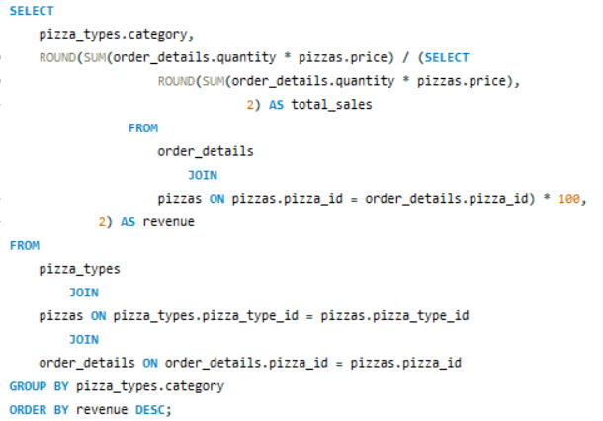
Calculate the percentage contribution of each pizza type to total revenue

Slide 13
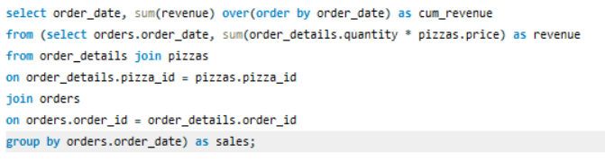
Analyze the cumulative revenue generated over time

Slide 14
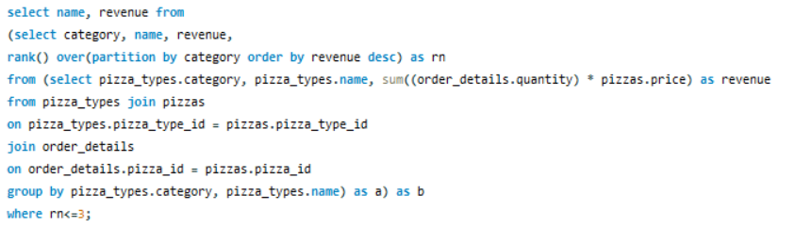
Determine the top 3 most ordered pizza types based on revenue for each pizza category

